Slide 1

EEL 4781 Computer Communication Networks Chapter 1-3: Introduction to Networking Concepts
Xin Xin
Department of Electrical and Computer Engineering
University of Central Florida

Slide 2
Agenda
Protocols and Protocol Layers
protocol
layers
encapsulation
Security
History
Summary

Slide 3



Protocols and Protocol Layers
What’s a protocol?
A human protocol and a computer network protocol:
Hi
TCP connection
request
Hi
TCP connection
response
Got the
time?
GET http://gaia.cs.umass.edu/kurose_ross
2:00
<file>
time
Q: other human protocols?
Notes:
Explain important points
distributed entities, exchanging messages (governed by protocols)
Time going down
go over definition of protocol (showing format, order of messages sent and received, and actions taken)
We’ll see these kinds of diagrams a lot

Slide 4
Protocols and Protocol Layers
What’s a protocol?
Human protocols:
“what’s the time?”
“I have a question”
introductions
… specific messages sent
… specific actions taken when message received, or other events
Network protocols:
computers (devices) rather than humans
all communication activity in Internet governed by protocols
Protocols define the format, order of messages sent and received among network entities, and actions taken on msg transmission, receipt

Slide 5
Protocols and Protocol Layers
Protocol “layers” and reference models
Networks are complex,
with many “pieces”:
hosts
routers
links of various media
applications
protocols
hardware, software
Question:
is there any hope of organizing structure of network?
…. or at least our discussion of networks?

Slide 6
Protocols and Protocol Layers
Example: organization of air travel
ticket (purchase)
baggage (check)
gates (load)
runway takeoff
airplane routing
ticket (complain)
baggage (claim)
gates (unload)
runway landing
airplane routing
airplane routing
airline travel: a series of steps, involving many services

Slide 7
Protocols and Protocol Layers
Example: organization of air travel
ticket (purchase)
baggage (check)
gates (load)
runway takeoff
airplane routing
ticketing service
ticket (complain)
baggage (claim)
gates (unload)
runway landing
airplane routing
baggage service
gate service
runway service
routing service
airplane routing
layers: each layer implements a service
via its own internal-layer actions
relying on services provided by layer below
Q: describe in words the service provided in each layer above

Slide 8
Protocols and Protocol Layers
Why layering?
dealing with complex systems:
explicit structure allows identification, relationship of complex system’s pieces
layered reference model for discussion
modularization eases maintenance, updating of system
change in layer's service implementation: transparent to rest of system
e.g., change in gate procedure doesn’t affect rest of system
layering considered harmful?
layering in other complex systems?

Slide 9
Protocols and Protocol Layers
source
Encapsulation
message
M
application
transport
network
link
physical
segment
H_{t}
M
H_{t}
datagram
H_{n}
H_{n}
H_{t}
M
frame
H_{l}
H_{n}
H_{t}
M
link
physical
switch
destination
H_{n}
H_{t}
M
network
link
physical
M
application
transport
network
link
physical
H_{l}
H_{n}
H_{t}
M
H_{n}
H_{t}
M
H_{t}
M
H_{n}
H_{t}
M
router
H_{l}
H_{n}
H_{t}
M

Slide 10
Protocols and Protocol Layers
Internet protocol stack
application: supporting network applications
IMAP, SMTP, HTTP
transport: process-process data transfer
TCP, UDP
network: routing of datagrams from source to destination
IP, routing protocols
link: data transfer between neighboring network elements
Ethernet, 802.11 (WiFi), PPP
physical: bits “on the wire”
application
transport
network
link
physical

Slide 11
Network security
field of network security:
how bad guys can attack computer networks
how we can defend networks against attacks
how to design architectures that are immune to attacks
Internet not originally designed with (much) security in mind
original vision: “a group of mutually trusting users attached to a transparent network” ☺
Internet protocol designers playing “catch-up”
security considerations in all layers!

Slide 12
Network security
Bad guys: malware
malware can get in host from:
virus: self-replicating infection by receiving/executing object (e.g., e-mail attachment)
worm: self-replicating infection by passively receiving object that gets itself executed
spyware malware can record keystrokes, web sites visited, upload info to collection site
infected host can be enrolled in botnet, used for spam or distributed denial of service (DDoS) attacks

Slide 13
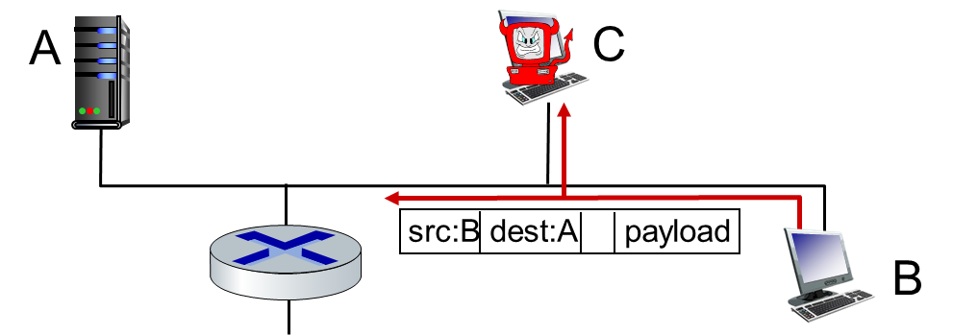
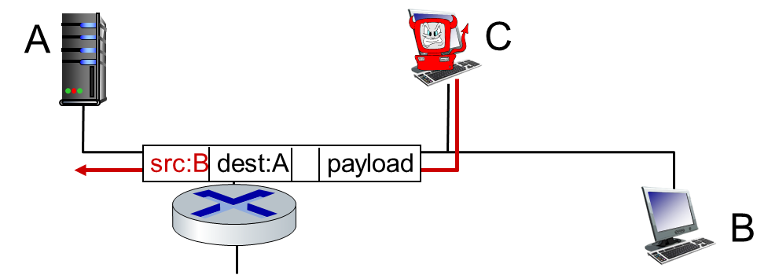
Network security
Bad guys: packet interception
packet “sniffing”:
broadcast media (shared Ethernet, wireless)
promiscuous network interface reads/records all packets (e.g., including passwords!) passing by
Bad guys: fake identity
IP spoofing: send packet with false source address
sniffing
spoofing

Slide 14
Network security
Bad guys: denial of service
Denial of Service (DoS): attackers make resources (server, bandwidth) unavailable to legitimate traffic by overwhelming resource with bogus traffic
1. select target
2. break into hosts around the network (see botnet)
3. send packets to target from compromised hosts
target

Slide 15
Network security
Lines of defense:
authentication: proving you are who you say you are
cellular networks provides hardware identity via SIM card; no such hardware assist in traditional Internet
confidentiality: via encryption
integrity checks: digital signatures prevent/detect tampering
access restrictions: password-protected VPNs
firewalls: specialized “middleboxes” in access and core networks:
off-by-default: filter incoming packets to restrict senders, receivers, applications
detecting/reacting to DOS attacks

Slide 16
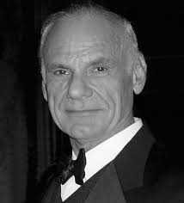
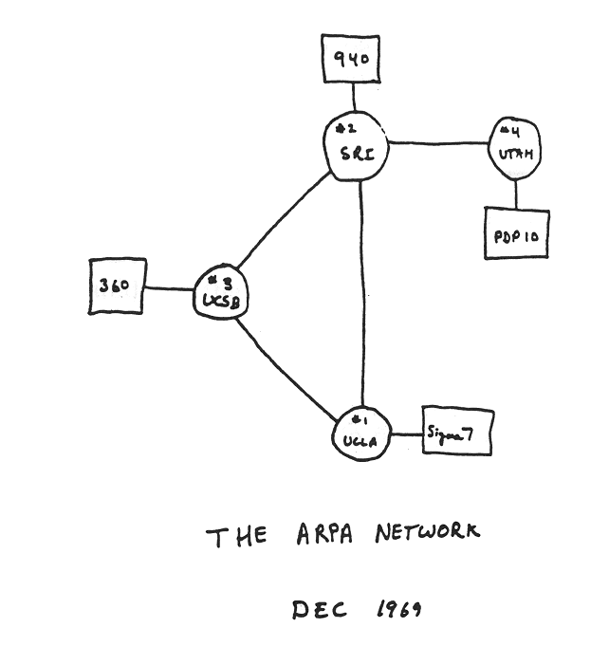
History
1961-1972: Early packet-switching principles
1961: Kleinrock - queueing theory shows effectiveness of packet-switching
1964: Baran - packet-switching in military nets
1967: ARPAnet conceived by Advanced Research Projects Agency
1969: first ARPAnet node operational
1972:
ARPAnet public demo
NCP (Network Control Protocol) first host-host protocol
first e-mail program
ARPAnet has 15 nodes
Larry Robert

Slide 17
History
1972-1980: Internetworking, new and proprietary nets
1970: ALOHAnet satellite network in Hawaii
1974: Cerf and Kahn - architecture for interconnecting networks
1976: Ethernet at Xerox PARC
late70’s: proprietary architectures: DECnet, SNA, XNA
late 70’s: switching fixed length packets (ATM precursor)
1979: ARPAnet has 200 nodes
Cerf and Kahn’s internetworking principles:
minimalism, autonomy - no internal changes required to interconnect networks
best-effort service model
stateless routing
decentralized control
define today’s Internet architecture

Slide 18
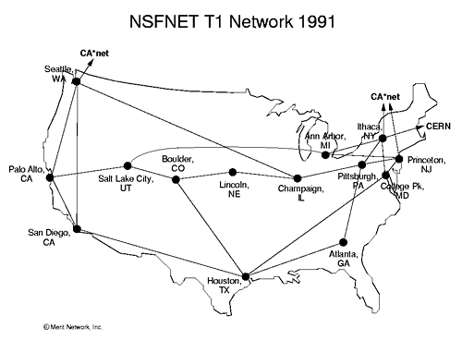
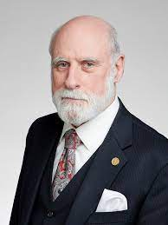
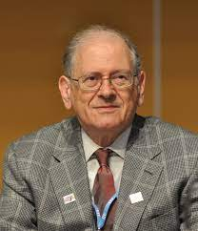
History
1980-1990: new protocols, a proliferation of networks
1983: deployment of TCP/IP
1982 - 1988: smtp e-mail protocol defined； DNS defined for name-to-IP-address translation； ftp protocol defined； TCP congestion control
new national networks: CSnet, BITnet, NSFnet, Minitel
100,000 hosts connected to confederation of networks
Vinton Cerf
Robert Kahn

Slide 19

History
1990, 2000s: commercialization, the Web, new applications
early 1990s: ARPAnet decommissioned
1991: NSF lifts restrictions on commercial use of NSFnet (decommissioned, 1995)
early 1990s: Web (World Wide Web application)
hypertext [Bush 1945, Nelson 1960’s]
HTML, HTTP: Berners-Lee
1994: Mosaic, later Netscape
late 1990s: commercialization of the Web
late 1990s – 2000s:
more killer apps: instant messaging, P2P file sharing
network security to forefront
est. 50 million host, 100 million+ users
backbone links running at Gbps
Tim Berners Lee

Slide 20
History
2005-present: more new applications, Internet is “everywhere”
aggressive deployment of broadband home access (10-100’s Mbps)
2008: software-defined networking (SDN)
increasing ubiquity of high-speed wireless access: 4G/5G, WiFi
content/service providers (Google, FB, Microsoft) create their own networks
bypass commercial Internet to connect “close” to end user, providing “instantaneous” access to social media, search, video content, …
enterprises run their services in “cloud” (e.g., Amazon Web Services, Microsoft Azure)
rise of smartphones: more mobile than fixed devices on Internet
rise of IoTs: ~15B devices attached to Internet

Slide 21
Chapter 1: summary
We’ve covered a “ton” of material!
Internet overview
network edge, access network, core
packet-switching versus circuit-switching
Internet structure
performance: loss, delay, throughput
protocol
layering, service models
security
history
You now have:
context, overview, vocabulary, “feel” of networking
more depth, detail, and fun to follow!

Slide 22
Thanks
Acknowledgment
The materials for this course are in part based upon the materials from a number of people/sources, including:
Official website of the Kurose and Ross text: Computer Networking: A Top-Down Approach
Official website of the Tanenbaum & Wetherall text: Computer Networks
Dr. Murat Yuksel: https://www.ece.ucf.edu/~yuksem/teaching/EEL-4781-Fall-2020.html
Dr. Raj Jain: https://www.cse.wustl.edu/~jain/

